Slide 1
Notradomocile
Project Definition and
Requirements Specification
By:
Ochaun Marshall, Christian Simaan, Jeremy Hutton, Richard Andrews

Slide 2
Approach
Problem:
It is difficult to determine whether a house will likely sell in a particular area.
and the most popular factors that lead to a house's sale in an area.
Solution:
We wish to create a web application that will display these factors and more, based upon a user's input of the location of their house.
NostraDomicile (our web application) will accomplish this using a frontend, backend, machine learning, and a database.
Our application will also retrieve information using Zillow API, and make evaluations upon the returned information.

Slide 3
Requirement Priority
The 1st tier features are the core of our application, and would need to be focused first. These are at the highest priorty
The 2nd tier features are also features we would like to have, but are not fundamental to our application. They would simply add more depth and desire to use our application. So their addition is based solely on time.
Lastly the 3rd tier features would be done once we finished all other tier features, and would mainly be longshots.

Slide 4
Features
1st tier:
Allow user to specify attributes for house qualities.
Obtain housing info using the Zillow API
Look for available houses within a zip code.
Create data visualizations based on home sales info.
Create a database to store housing info, query, and run data through machine learning algorithms.
Server side backend connected to database and frontend of web application.
Obtain a cloud hosting service (AWS)
Do frontend of website.
User able to determine whether a house will sell or not based on attributes and zip code.
User able to find the most desirable factors in a zip code.
2nd tier:
Determine if a house will sell at a given price.
Predict a viable sales price for given attributes.
Rank realtors by sales count.
3rd tier:
Suggest attributes to increase sales price.
Email results printout to users.
Provide suggested product links based on most important factors.

Slide 5
System Model
The frontend will handle both displaying information to the user, and getting data from the user that will allow our application to analyze attributes.
The backend will analyze the data that the frontend gets, and send it to the machine learning functions/system. The backend will also make request to the zillow api or our database depending on the request made, and whether we have the data required.
We will use the Random Forest Classifier to analyze the data it gets from the backend, and provide answers to the backend.
The database will store information we get from requests to the zillow API, as well as any other information we need to store.

Slide 6
Diagram of System Model

Slide 7
Subsystems
Frontend: The angular and bootstrap will be broken down into sections. Some sections will be dedicated to explaining to the user what this web application does. Other sections will get user input from the user in order to feed the input into the backend. Lastly several other sections will be about displaying the information that is retrieved from the backend after it has been analyzed.
Backend: The Django backend will also be broken into many different functions, but it will follow a MVC format. Functions such as making calls to the Zillow API, querying the database, sending data to the frontend to be displayed, etc.

Slide 8
Subsystems
Database: The MySQL database will be broken up into tables of information. The information will be comprised of zip codes, indicators of whether a house has sold or not, attributes of said house, status of users, and so forth. This information can then be updated via queries from the backend as new data becomes available.
Random Forest:The machine learning classifier that will be used is the Random Forest. It generates a ensemble of decision and uses the majority classification of those trees to determine result. I will be implemented using Scikit-learn library in Python.
Visualisations: Will be generated using the MatPlotlib

Slide 9
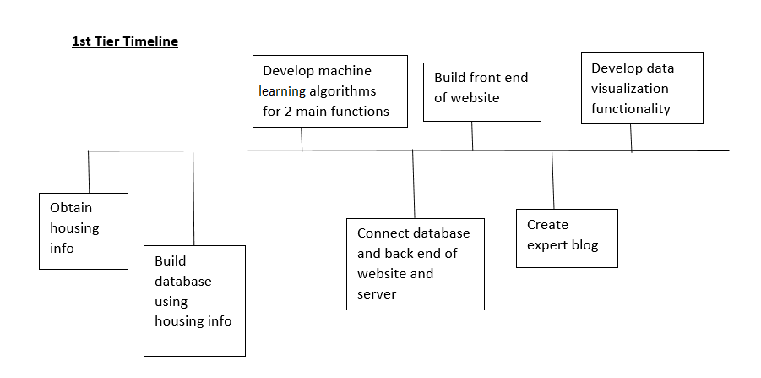
Timeline and Feasibility

Slide 10
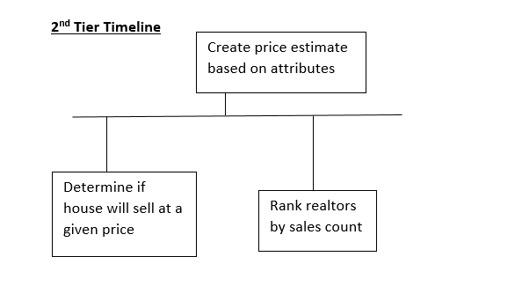
Timeline and Feasibility (cont.)

Slide 11
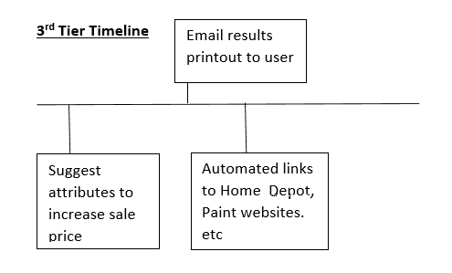
Timeline and Feasibility (cont.)

Slide 12
Alternative models
The model we chose to use is the following setup: AngularJS and Bootstrap for the frontend, Django for backend programming, Python for machine learning, MySQL for database, and AWS for cloud hosting. The following slides will show the pros and cons of our choice vs. an alternative model that we were considering.

Slide 13
Architecture decisions: AngularJS & Bootstrap vs. Pure HTML/CSS
AngularJS & Bootstrap
Pro: It uses MVC, so it’s more organized.
Pro: It’s easier to manipulate DOM.
Pro: Write less code.
Pro: Consistency and responsive.
Con: Experience.
Con: Have to include the dependencies of both frameworks.
Pure HTML/CSS
Pro: Can write/code only what you need, instead of strictly following MVC.
Pro: None, or not as many, dependencies.
Con: Not as consistent or responsive.
Con: Harder to manipulate DOM.

Slide 14
Architecture decisions: Ruby on Rails VS Django
Django
Pro: Since we’re doing our machine learning in Python, we wouldn’t have to use too many different languages as it may over complicate things.
Pro: Better code readability since it uses Python (Indents).
Con: No experience with this framework.
Ruby on Rails
Pro: Some experience with this framework.
Pro: Probably has a better edge over Django for web development.
Con: Wouldn’t as easily tie in with the machine learning because of the separate languages.

Slide 15
Hosting decision: Cloud Hosting vs Local Hosting
Cloud
Pro: Cloud hosting would give us 24/7 access.
Pro: It wouldn’t expend individual members computing resources.
Pro: Easier to scale.
Pro: Has support if we run into problems.
Con: Cost money.
Con: Requires internet access.
Localhost
Pro: More control.
Pro: Free.
Pro: More security.
Con: We might have problems presenting via localhost.

Slide 16
Database decision: MySQL VS MongoDB
MySQL
Pro: Several members of our group have experience with MySQL.
Pro: Is a relational database, so handles a lot of work automatically that we might not want to handle manually.
Con: Not as fast as a NoSQL database would be.
MongoDB
Pro: Possibly faster.
Pro: Better performance if tweaked right.
Con: Responsible for more work that a relational database would do automatically.
Con: No experience with NoSQL databases.

Slide 17
Roles and Responsibilities
Frontend: Jeremy Hutton
Backend: Richard Andrews
Database: Christian Simaan
Machine Learning: Ochaun Marshall
Note: When any member finishes work in their role, they will help with another role where needed and/or appropriate.

